Slide 1



Programming in Python

Slide 2
Outline
Day 1: Why program, printing, variables.
Day 2: Data types, input(), arithmetic operations.
Day 3: Conditions, if-elif-else, boolean logic.
Day 4: Loops: while, for, range().
Day 5: Functions and lists.
Day 6: Project review, Python career paths.

Slide 3
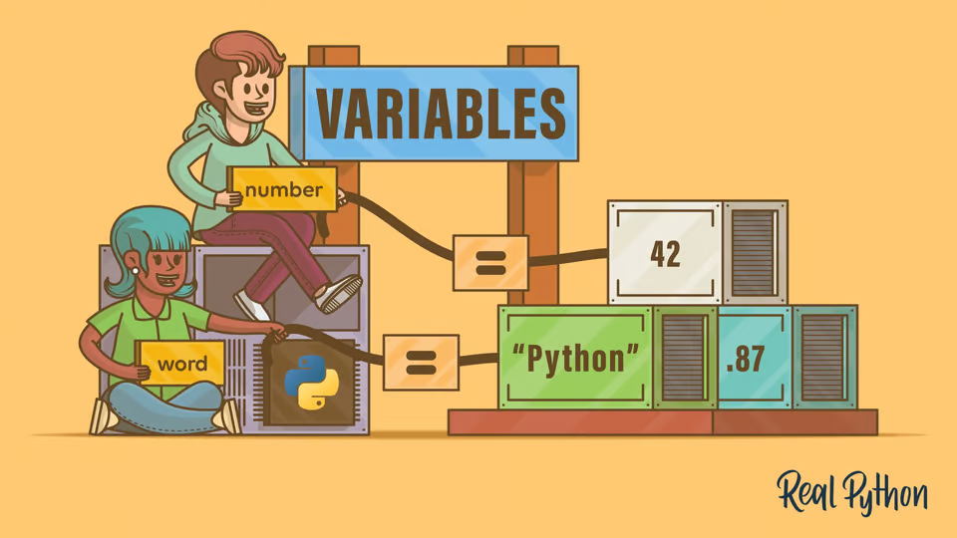
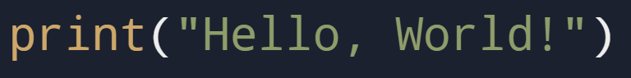
Day 1

Slide 4
Objectives
Why learn programming?
What is Python?
Python “Environment”
Print()
Variables

Slide 5
Benefits of Learning Programming
Improves logical thinking and problem-solving skills.
High demand for skilled programmers in various industries.
Fun and rewarding: Create something meaningful from scratch.

Slide 6
What and Why Python?
Developed by Guido van Rossum in 1991.
General-purpose programming language.
Known for:
Simple and readable syntax.
A large community and extensive libraries.
Popular for:
Web apps, AI/ML, automation, data analysis, etc.

Slide 7



Setting Up Your Python Environment
Notes:
Explain a little about IDE, show an example of writing code in notepad

Slide 8
print()
Notes:
Explain a little about IDE, show an example of writing code in notepad

Slide 9

Task 1: Google Classroom and Printing
Description:
Sign in to the Google Classroom
Write code to print the following sentences:
Free Palestine.
I am EXCITED to learn python.
Write code to print anything you’d like (Be Creative✨)
Submit the code on Google Classroom in Task 1
Notes:
Explain a little about IDE, show an example of writing code in notepad

Slide 10
755ojqu
Notes:
Explain a little about IDE, show an example of writing code in notepad

Slide 11
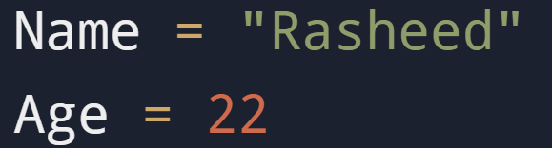
What Are Variables?
Notes:
Explain a little about IDE, show an example of writing code in notepad

Slide 12
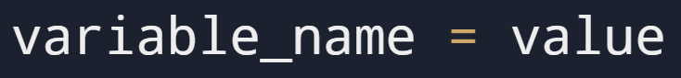
Creating Variables
Rules:
Must start with a letter or underscore (_).
Cannot start with a number.
No spaces or special characters.
Must not be a reserved word.
Notes:
Explain a little about IDE, show an example of writing code in notepad

Slide 13
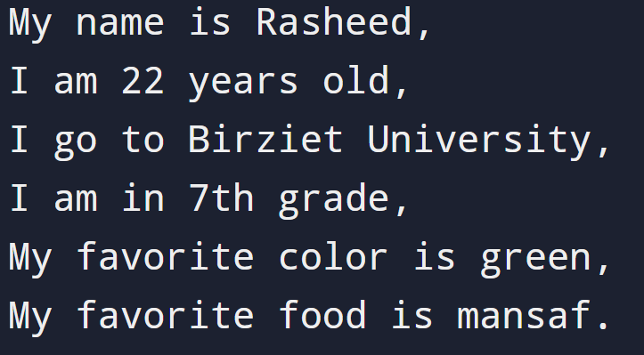
Task 2: Introduce Yourself
Description:
Create a variable for the following:
your name.
your age.
your school.
your class.
your favorite color.
your favorite food.
Use the print function to print them like the Image
Notes:
Explain a little about IDE, show an example of writing code in notepad

Slide 14
Why Are Variables Important?
Storing user input.
Simplifying repetitive tasks.
Keeping track of game scores, calculations, etc.

Slide 15
Summary

Slide 16
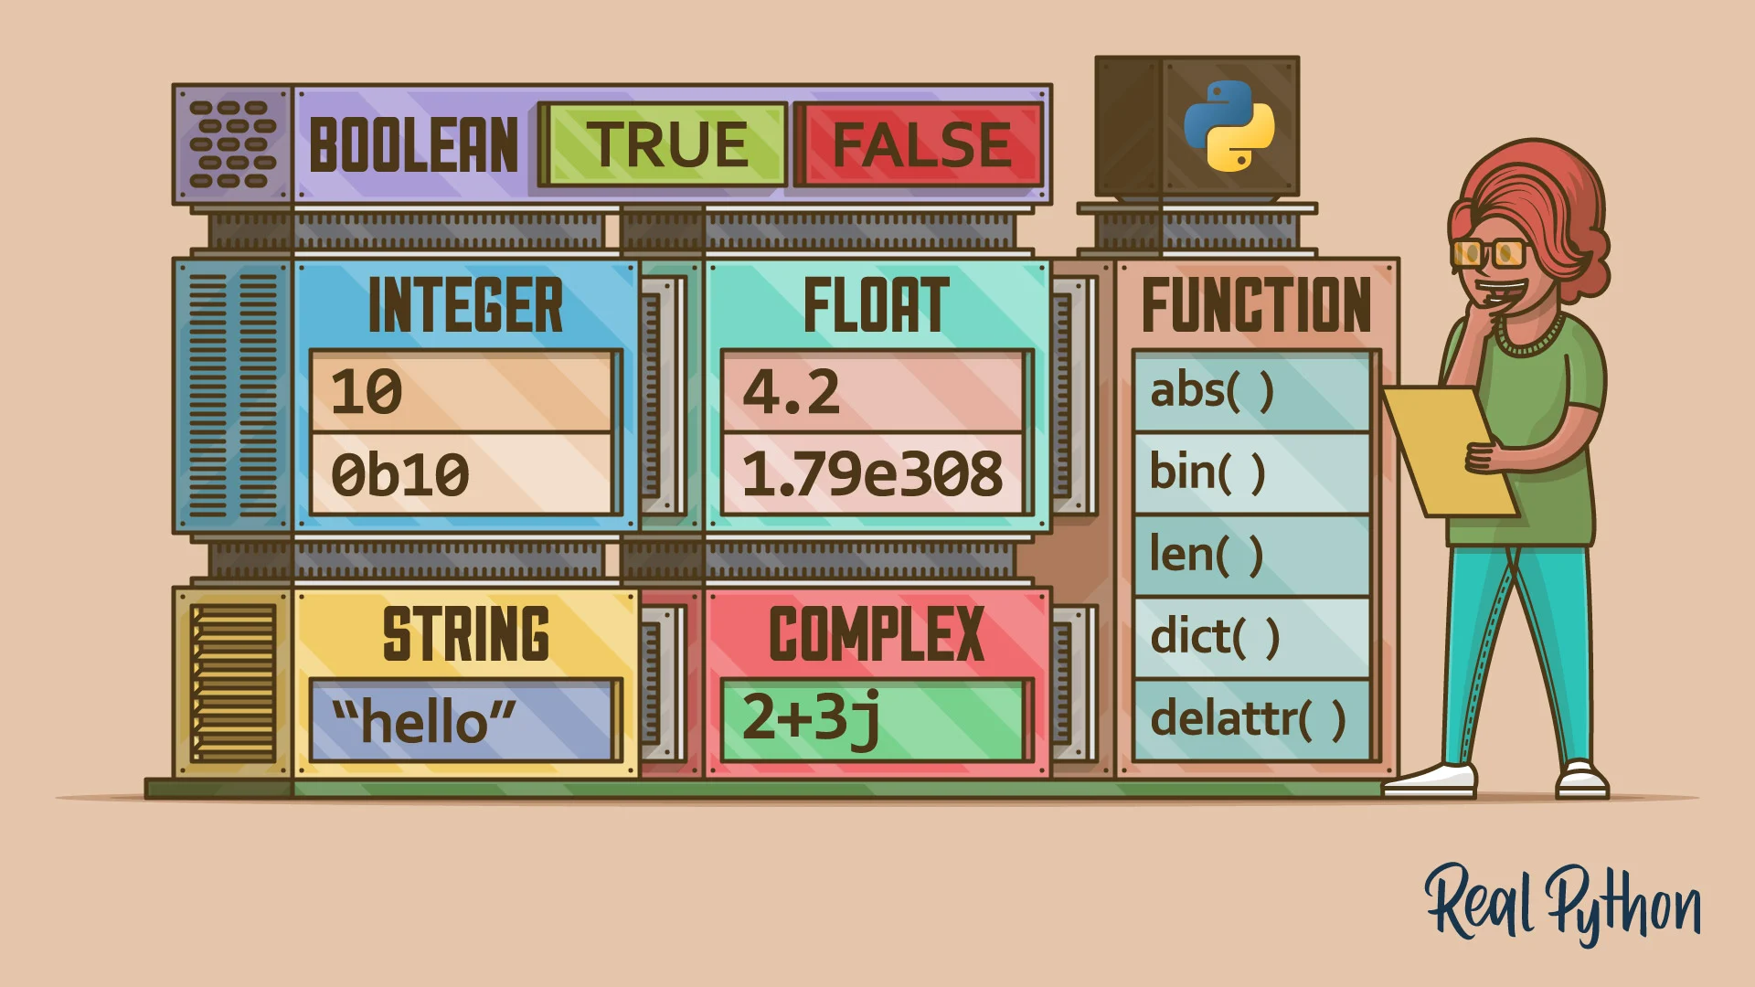
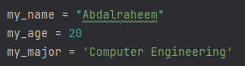
Day 2

Slide 17
Objectives
What are data types ?
How to choose the correct data type
Casting
input()
Arithmetic - (+, -, *, /, etc…)

Slide 18
Data types
Some of most common data types:
Integers
Float
Characters
Strings
Boolean

Slide 19
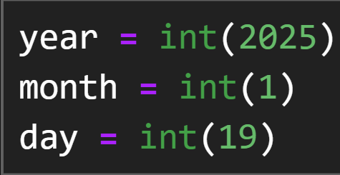
Integers

Slide 20
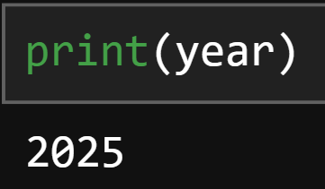
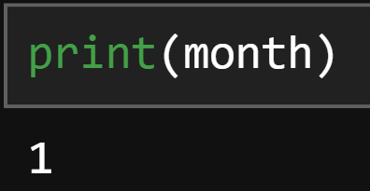
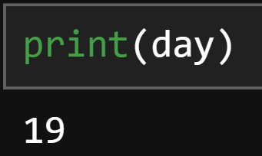
Integers

Slide 21
Integers
Try it yourself! - Write your birthday
year = int(_)
month = int(_)
day = int(_)

Slide 22
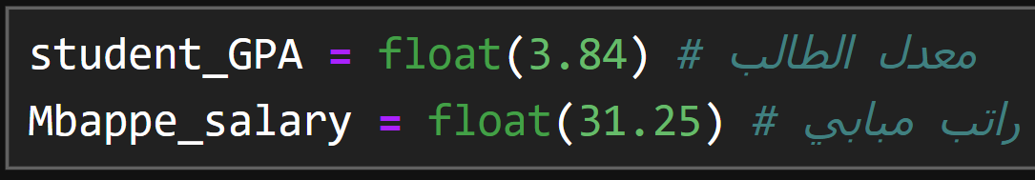
Floats

Slide 23
Integer VS Float
You don’t have to specify the type - مش محتاج تحدد نوع المتغيرات
Python is SMART

Slide 24
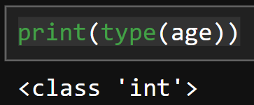
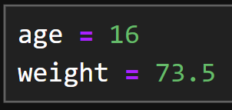
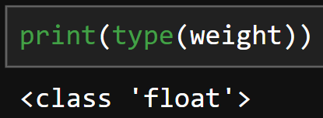
type()

Slide 25
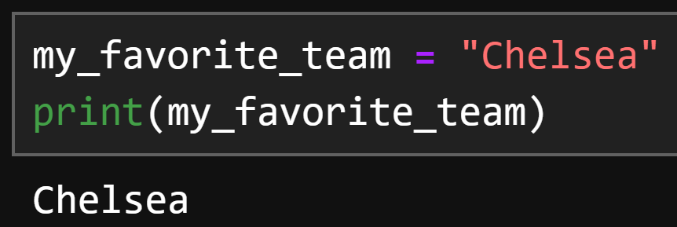
“Strings”

Slide 26
Task 1: Determine the type
Write a code that prints to you the type of the followings - اكتب كود بطبع نوع التالي
TRY TO GUESS IT FIRST - حاول خمن بالاول
Year = 2004
Weight = 120.0
Phone_number = “0599999999”

Slide 27
Casting
Is there a way to convert from Integer to String
or from float to integer?
هل في طريقة احول من نوع بيانات للاخر ؟

Slide 28
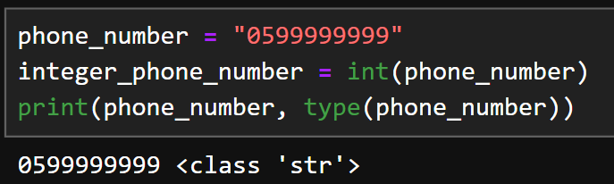
Casting - String to Integer

Slide 29
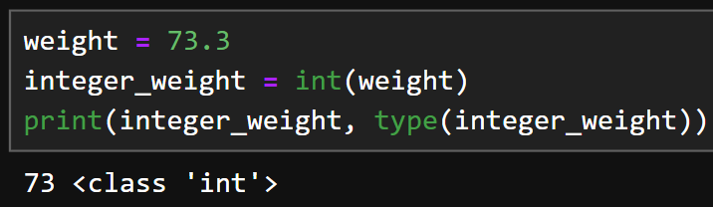
Casting - Float to Integer

Slide 30
input()
How can I read data from the user ?
كيف أقرأ البيانات من المستخدم ؟

Slide 31
input()

Slide 32
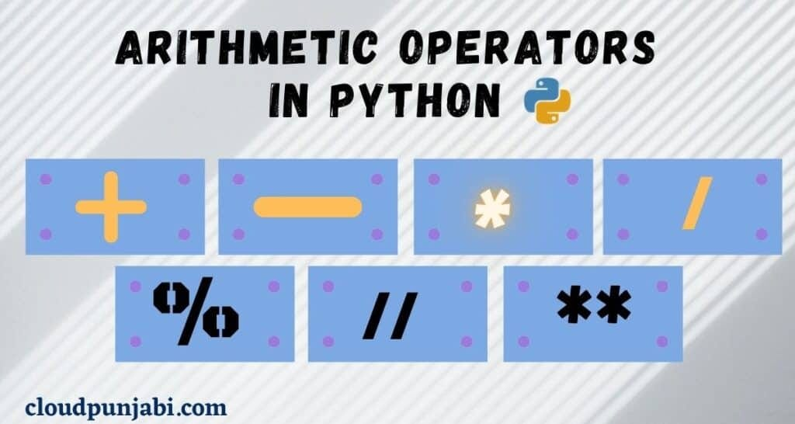
Arithmetic

Slide 33
Arithmetic
Some python operations - بعض العمليات الحسابية في بايثون
+
*
/
**
%

Slide 34
Add and Subtract
ADD +
SUBTRACT -
جمع +
طرح -

Slide 35
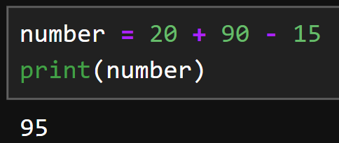
Add and Subtract
Doing calculations through numbers directly
القيام بالعمليات الحسابية مباشرة

Slide 36
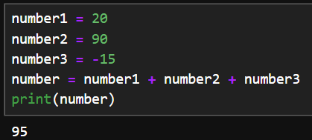
Add and Subtract
Doing the calculations through variables
القيام بالعمليات الحسابية باستخدام متغيرات

Slide 37
Multiply and division
Multiply *
Divide /
ضرب *
قسمة /

Slide 38
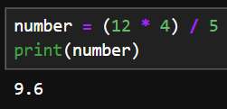
Multiply and division

Slide 39
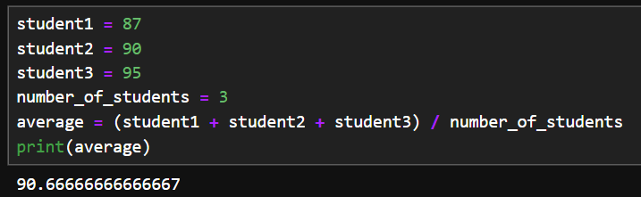
Multiple operations

Slide 40
Power
Power **
القوة **
example)
Number = 6
Square = Number ** 2

Slide 41
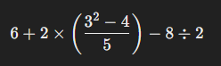
Task 2 - Arithmetics
Write a program that calculate this operation and saves it in variable
Feel free to use many variable as you want

Slide 42
Even and Odd
How to know if a number is even or ODD ?
كيف تعرف اذا الرقم فردي او زوجي ؟

Slide 43
Even and Odd
YES, you can know if a number is even or odd if it’s divisible by “2”,
If the number remaining is 0 then it’s divisible else it’s not
إذا كان الرقم قابل للقسمة على 2 (باقي القسمة على 2 صفر) بكون زوجي, غير هيك فردي

Slide 44
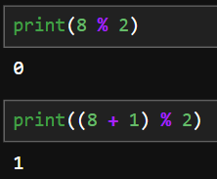
Modules %
You can see that the first number (8) remaining when dividing by 2 is 0
but when adding 1 to it it’s not
ال 8 بتقسم على 2, باقي القسمة صفر
ال 9 ما بتقسم على 2, باقي القسمة مش صفر

Slide 45
HOMEWORK

Slide 46
Homework
Write a program that takes 3 numbers from the user and then calculate their variance
اكتب برنامج بقرأ 3 ارقام من المستخدم بعدين بحسب التشتت

Slide 47
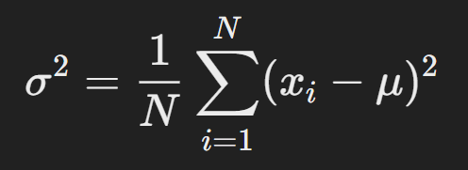
Variance equation
σ: variance - التشتت
N: number of numbers - عدد الارقام
∑: Summation - مجموع
xi​ : each number - كل رقم
μ: Mean or Average - المتوسط

Slide 48
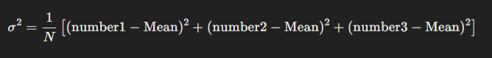
Variance example
Suppose we have three numbers
Note: Mean is the same as average which we measured earlier

Slide 49
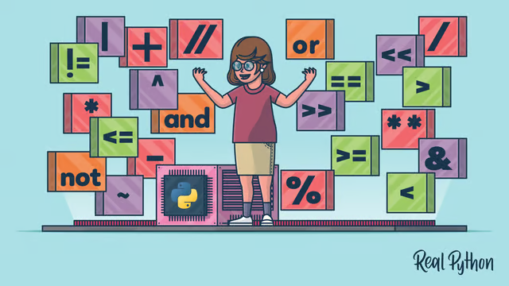
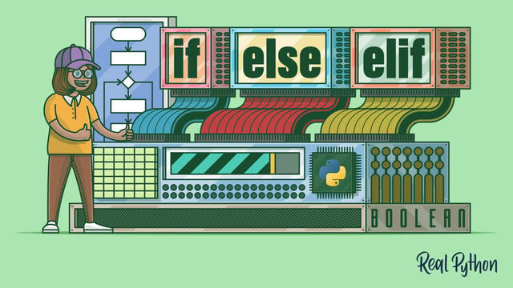
Day 3
Comparison & logical operators, and logical expressions.
If-else statements (conditionals.)

Slide 50
Objectives
Understand how operators are used to form conditions.
Apply comparison operators to compare values.
Combine logical and comparison operators.
Get to know conditionals and their types.
Use logical expressions in conditional statements.

Slide 51
Comparison and Logical Operators
The Building Blocks of Decision-Making
Operators are symbols or keywords that perform operations on values or variables.
We’ll be exploring two types:
Comparison Operators: To compare values or variables, such as: <, >, <=, >=, ==, !=.
Logical Operators: To combine or manipulate conditions, such as: and, or, not.
age > 18
y <= 92
z == y
first_name == "John" and last_name == "Doe"
2 == (2 * x) or 2 != (2 * x)
not age > 18 and age >= 13

Slide 52
Comparison Operators
Operator | Description | Example | Result
== | Equal to | 1 == 1 | True
!= | Not equal to | 2 != 3 | True
< | Less than | 3 < 5 | True
> | Greater than | 7 > 10 | False
<= | Less than or equal to | 3 <= 3 | True
>= | Greater than or equal to | 4 >= 3 | True
x = 10
y = 20
print(x < y) # True
age = 24
is_adult = age > 18
print(is_adult)# True

Slide 53
Logical Operators
Operator | Description | Example | Result
and | True if both conditions are true. False if one of them is false. | True and True | True
 |  | True and False | False
or | True if at least one condition is true. False if both are false. | True or False | True
 |  | False or False | False
not | True if the condition is false. (Inverts the condition) | not False | True
 |  | not True | False
age = 24
is_adult = age > 18
has_license = True
can_drive = is_adult and has_license
print(can_drive) # True

Slide 54
Logical Operators
print(5 < 7 and 3 == 3) # True
print(5 < 7 and 3 != 3) # False
print(5 > 7 and 3 == 3) # False
print(5 > 7 and 3 != 3) # False
print(5 < 7 or 3 == 3) # True
print(5 < 7 or 3 != 3) # True
print(5 > 7 or 3 == 3) # True
print(5 > 7 or 3 != 3) # False
print(not 5 < 7) # False
print(not 5 > 7) # True
print(not 0) # True
print(not 1) # False

Slide 55
Tasks
Create two variables, a and b, and assign them any numbers. Write expressions using (==, >, <, and, or, not).
Assign three numbers to x, y, z. Write an expression to check if x is the largest of the three.

Slide 56
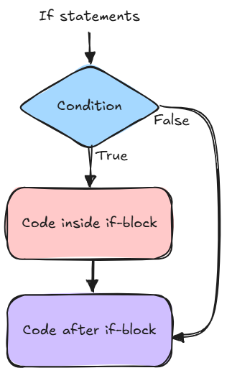
If-else statements (Conditionals)
How Programs Make Decisions
Conditionals are used to perform actions (code) based on whether a condition is True or False.
Conditions: Expressions that equal True or False, consisting of comparison and/or logical operators
Blocks of Code: Code inside the if-statement block, which only runs if the condition is true. Indicated by an indentation at the beginning of each line inside the block (after the condition).

Slide 57
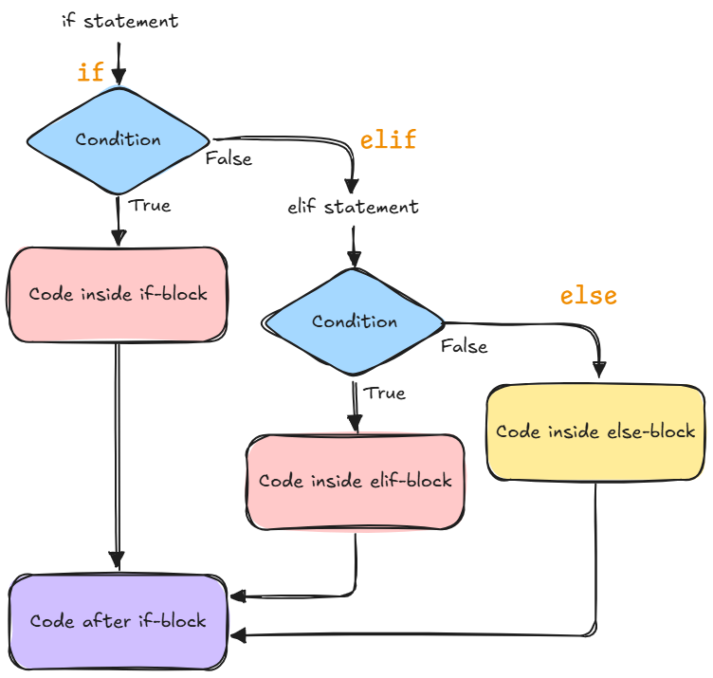
Types of Conditional Statements
There are three types of conditional statements, each serves a certain purpose:
if
if-else
elif

Slide 58
The if Statement
Structure:
Example:
if condition:
# code to execute if the condition is True
age = 18
if age >= 18:
print("You are an adult!")

Slide 59
The if-else Statement
Structure:
Example:
if condition:
# code to execute if the condition is True
else:
# code to execute if the condition is False
temperature = 25
if temperature > 25:
print("It's hot outside.")
else:
print("It's a pleasant day.")

Slide 60
The elif Statement
Structure:
Example:
if condition1:
# code to execute if condition1 is True
elif condition2:
# code to execute if condition2 is True
else:
# code to execute if none of the conditions are True
mark = 85
if mark >= 90:
print("Grade: A")
elif mark >= 75:
print("Grade: B")
else:
print("Grade: C")

Slide 61
Using Logical Operators in Conditionals
The logical operators and expressions we talked about earlier can be used with conditionals to create more complex conditions.
temperature = 27
if temperature > 35:
print("It's REALLY hot! 🥵☀️")
elif temperature > 30:
print("It's hot.")
elif temperature > 20 and temperature <= 30:
print("It's warm.")
elif temperature <= 0:
print("It's freezing! 🥶❄️")
else:
print("It's cold.")

Slide 62
Tasks
Ask the user to input a number. Print whether it’s positive, negative, or zero. And print whether it’s even or odd. remember: x % 2 returns 0 if x is divisible by 2 (even).
Ask the user to input their marks. Print the grade based on the following:
Grade A: marks greater than 90.
Grade B: marks less than 90 and greater than or equal to 75.
Grade C: marks less than 75 and greater than or equal to 50.
Grade F: marks less than 50.

Slide 63
HOMEWORK

Slide 64
Homework
Create a simple quiz program. Think of three questions to ask the user (for example: 4 * 7, capital of a country, name of a song, etc.)
Take input from the user for each question, and store the answer in a variable.
Use if/if-else/elif statements to check the answers (in case a question can have multiple correct answers).
Keep a score and print it after the quiz is done.
Feel free to print whatever you want based on the user’s score. (You can also use conditionals to print different results if the user got 3/3, 2/3, 1/3, or 0/3 score).
Hint: Create a variable score at the beginning and assign it to 0. And inside each correct block, add 1 to it.

Slide 65
Day 4

